Slide 1

Expressions
In PowerPoint, click on speaker icon and then click "Play" button to hear narration.

Slide 2

Expressions
An expression is a combination of one or more operators and operands.
Arithmetic expressions compute numeric results using the arithmetic operators:
Addition +
Subtraction -
Multiplication *
Division /
Remainder %

Slide 3
Division and Remainder
If both operands to the division operator (/) are integers, the result is an integer
The fractional part is discarded.
Integer division results in truncation, not rounding.
14 / 3 equals
4
8 / 12 equals
0
The remainder operator (%) returns the remainder from dividing the first operand by the second.
14 % 3 equals
2
8 % 12 equals
8

Slide 4
Operator Precedence
Operators can be combined into complex expressions
result = total + count / max - offset;
The order in which the operations are done is important.
Multiplication, division, and remainder are evaluated prior to addition, subtraction, and string concatenation.
Arithmetic operators with the same precedence are evaluated from left to right, but parentheses can be used to force the evaluation order.

Slide 5
Operator Precedence
What is the order of evaluation in the following expressions?
a / (b + c) - d % e
2
1
4
3
a / (b * (c + (d - e)))
4
3
2
1
In PowerPoint, click on the slide to show sucessive results.

Slide 6
Exercises
Given the declarations below, find the result of each expression (in a Java program).
int a = 3, b = 10, c = 7;
a / b
b / a
b % a
Answers on next slides.

Slide 7
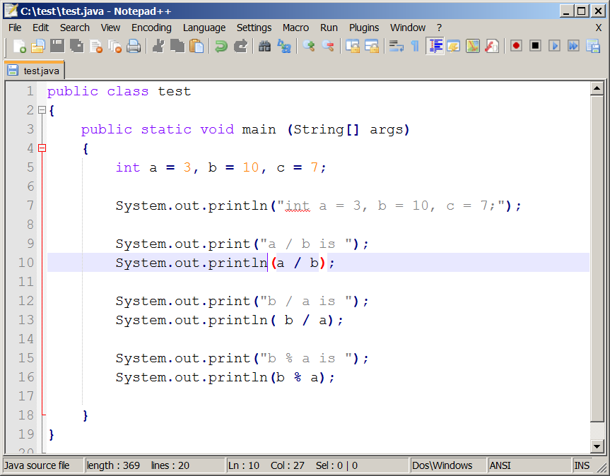
Program to answer exercise

Slide 8
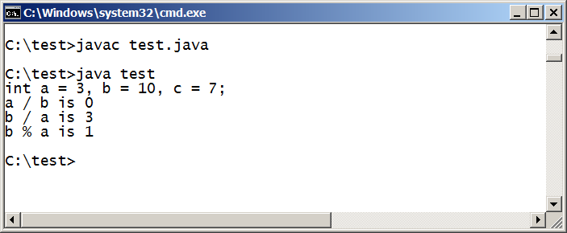
Exercise Answers

Slide 9
Assignment Revisited
The assignment operator has a lower precedence than the arithmetic operators
First the expression on the right hand
side of the = operator is evaluated
answer = sum / 4 + MAX * lowest;
4
1
3
2
Then the result is stored in the
variable on the left hand side
In PowerPoint, click on the slide to show sucessive results.

Slide 10
Exercise
Given two integer variables
matriculationAge and graduationAge ,
write a statement that gives graduationAge a value that is 4 more than the value of matriculationAge .

Slide 11
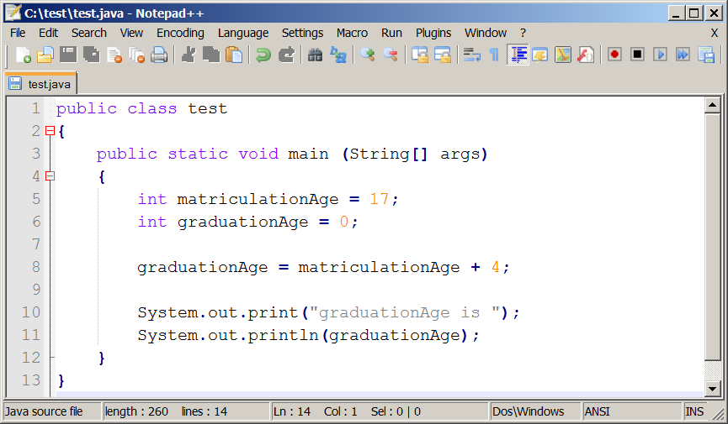
Program to answer exercise

Slide 12
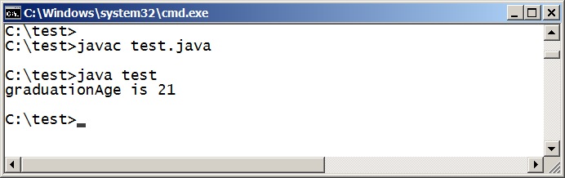
Program to answer exercise running

Slide 13
Assignment Operators
Often we perform an operation on a variable, and then store the result back into that variable. Java provides assignment operators to simplify that process
For example, the statement
num += count;
is equivalent to
num = num + count;

Slide 14
Assignment Operators
Operator
+=
-=
*=
/=
%=
Example
x += y
x -= y
x *= y
x /= y
x %= y
Equivalent To
x = x + y
x = x - y
x = x * y
x = x / y
x = x % y
There are many assignment operators in Java, including the following:

Slide 15
Assignment Operators
The right hand side of an assignment operator can be a complex expression
For example,
result /= (total-MIN) % num;
is equivalent to
result = result / ((total-MIN) % num);

